Slide 1
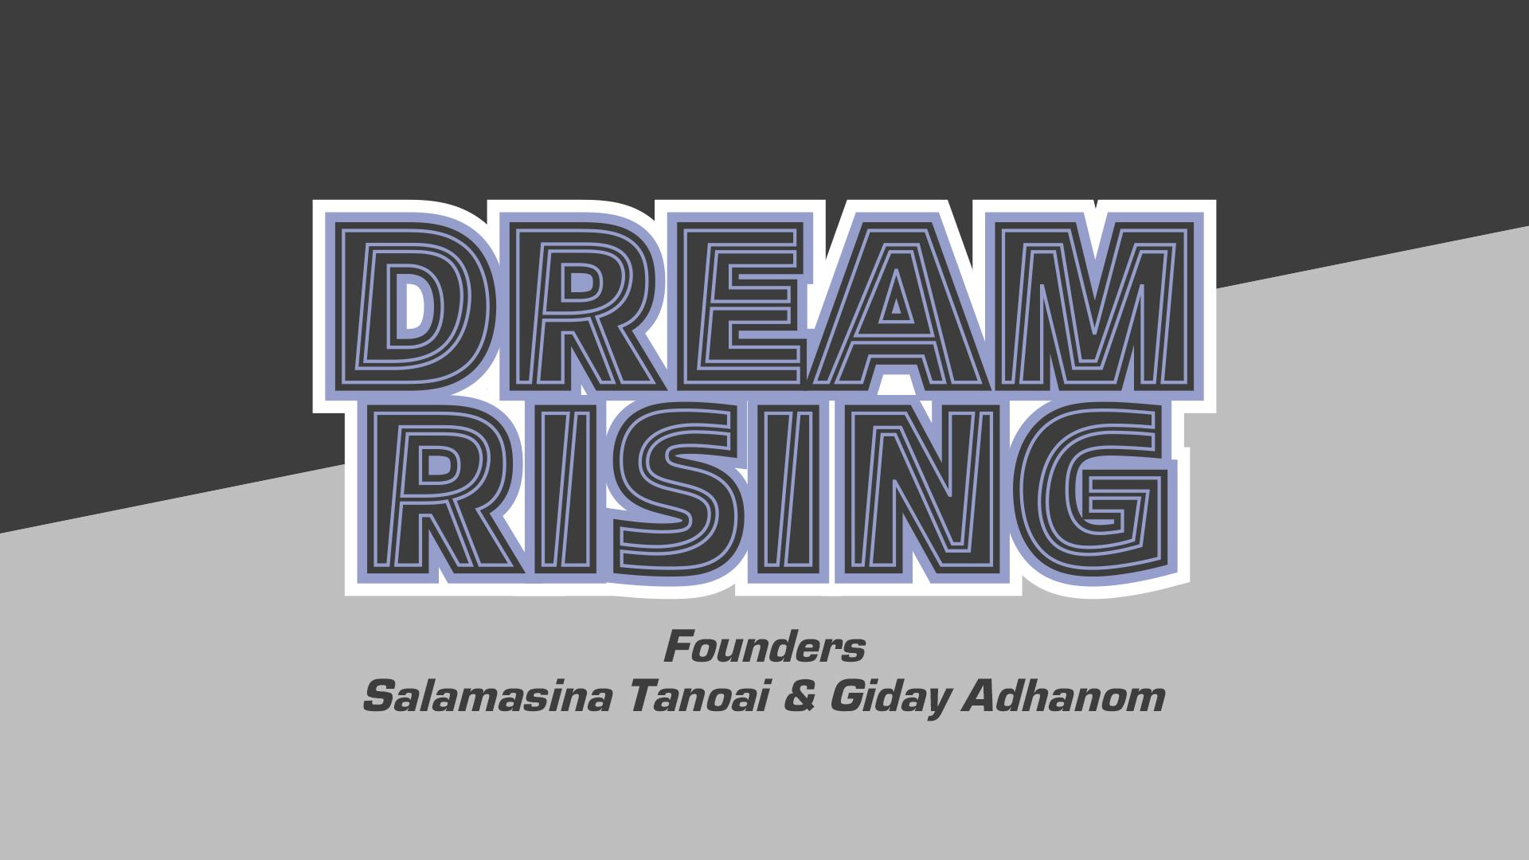

Slide 2
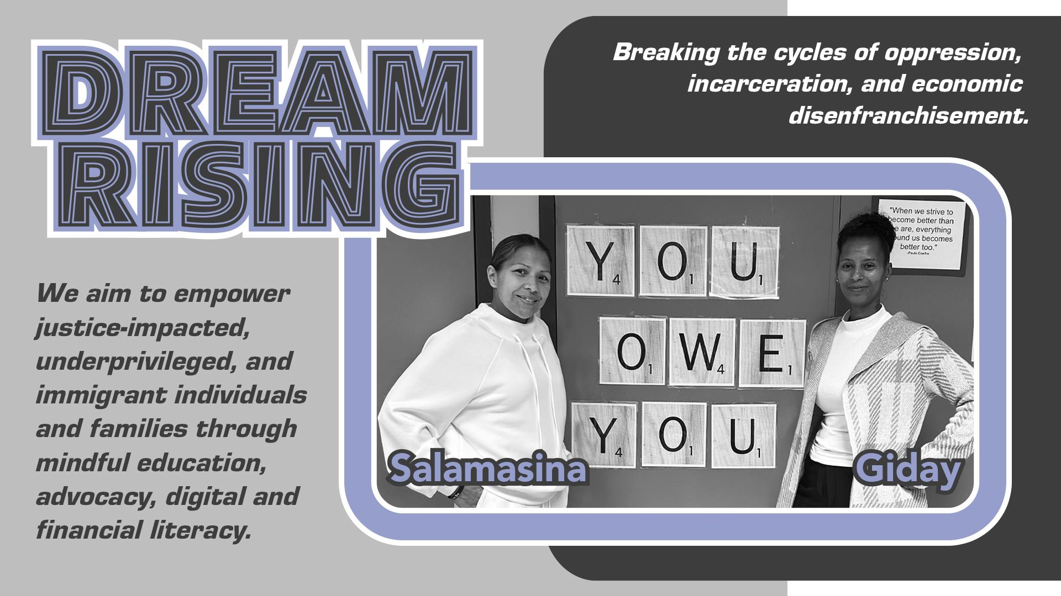

Slide 3
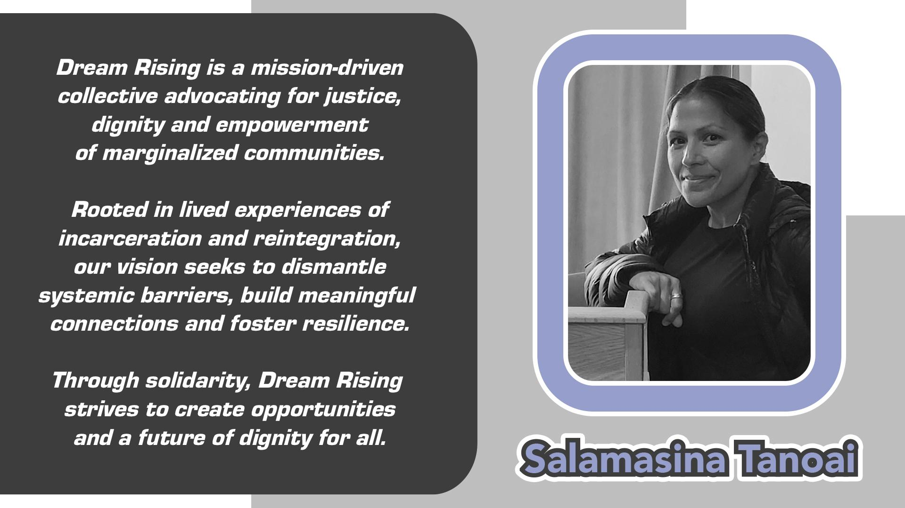

Slide 4
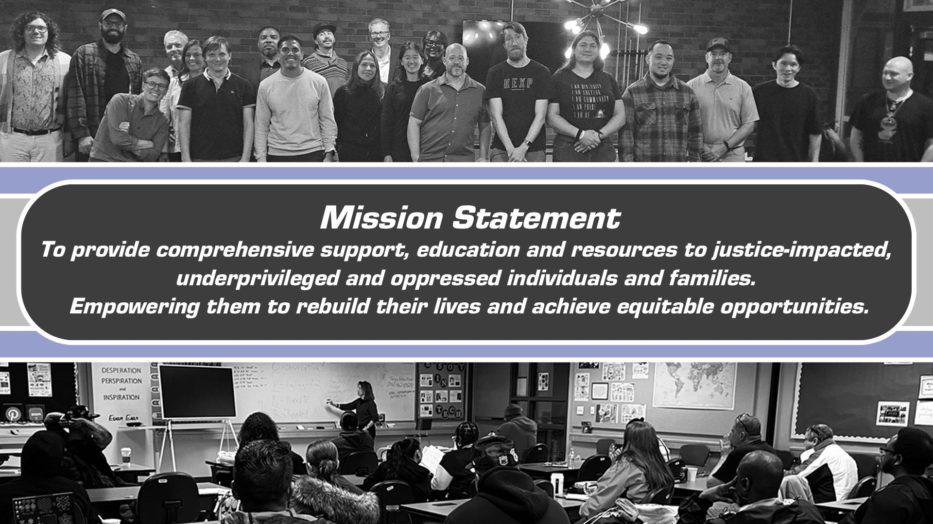

Slide 5
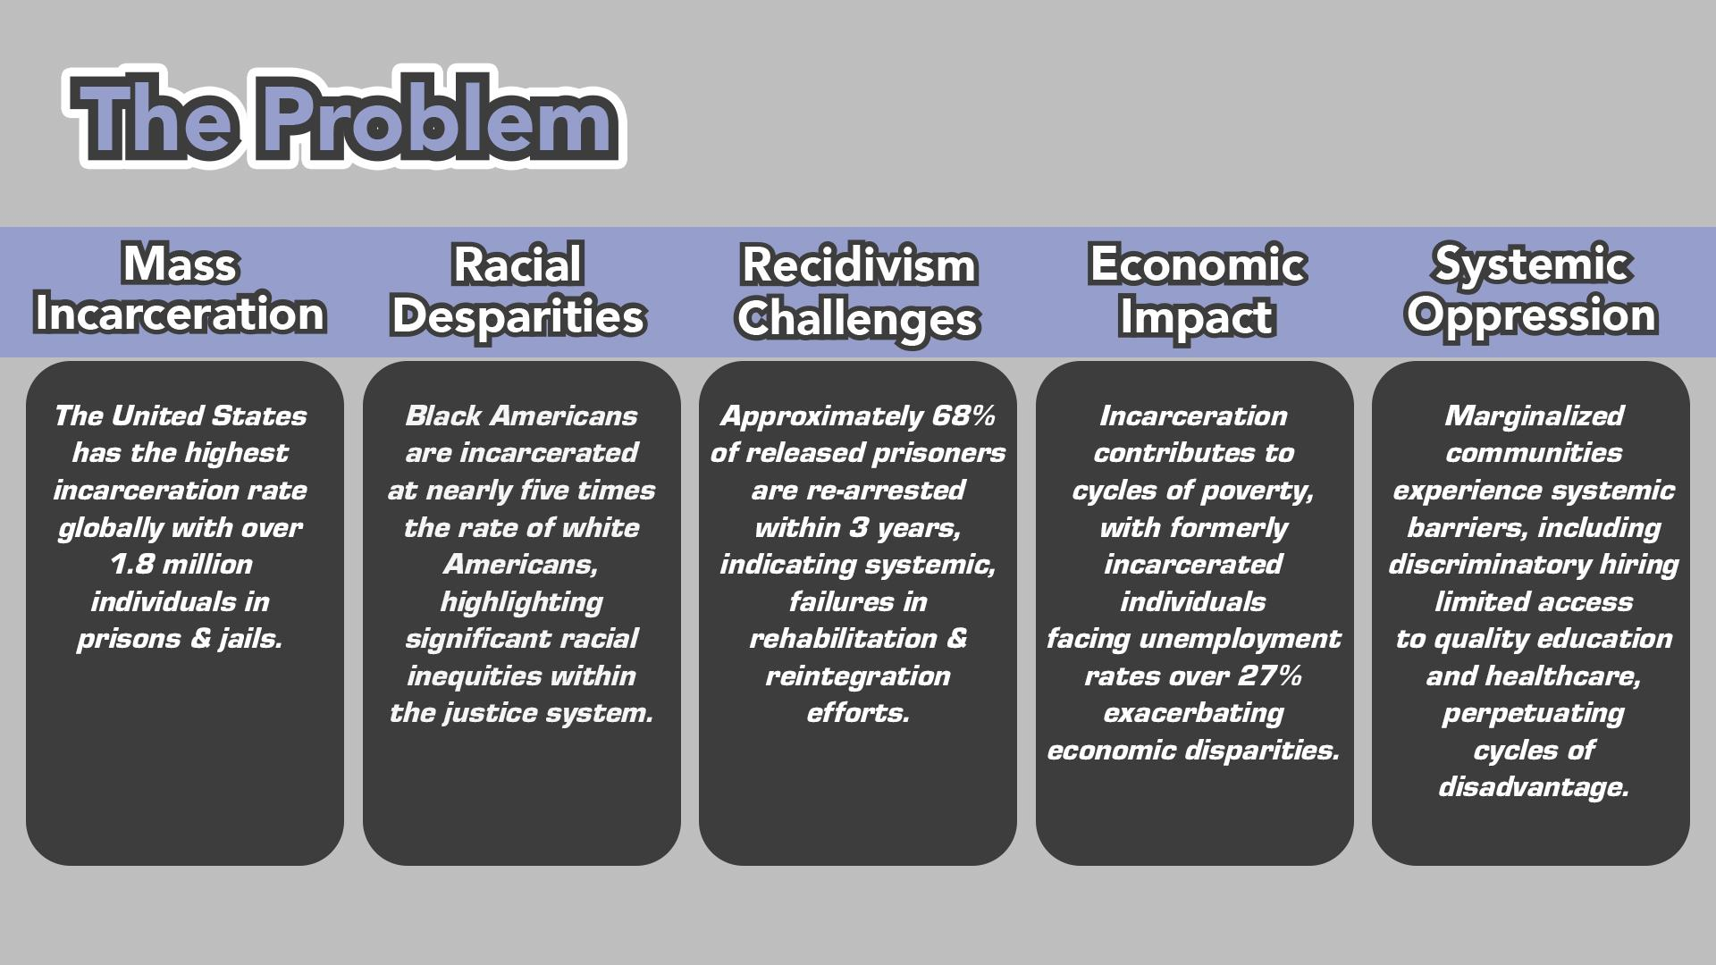

Slide 6
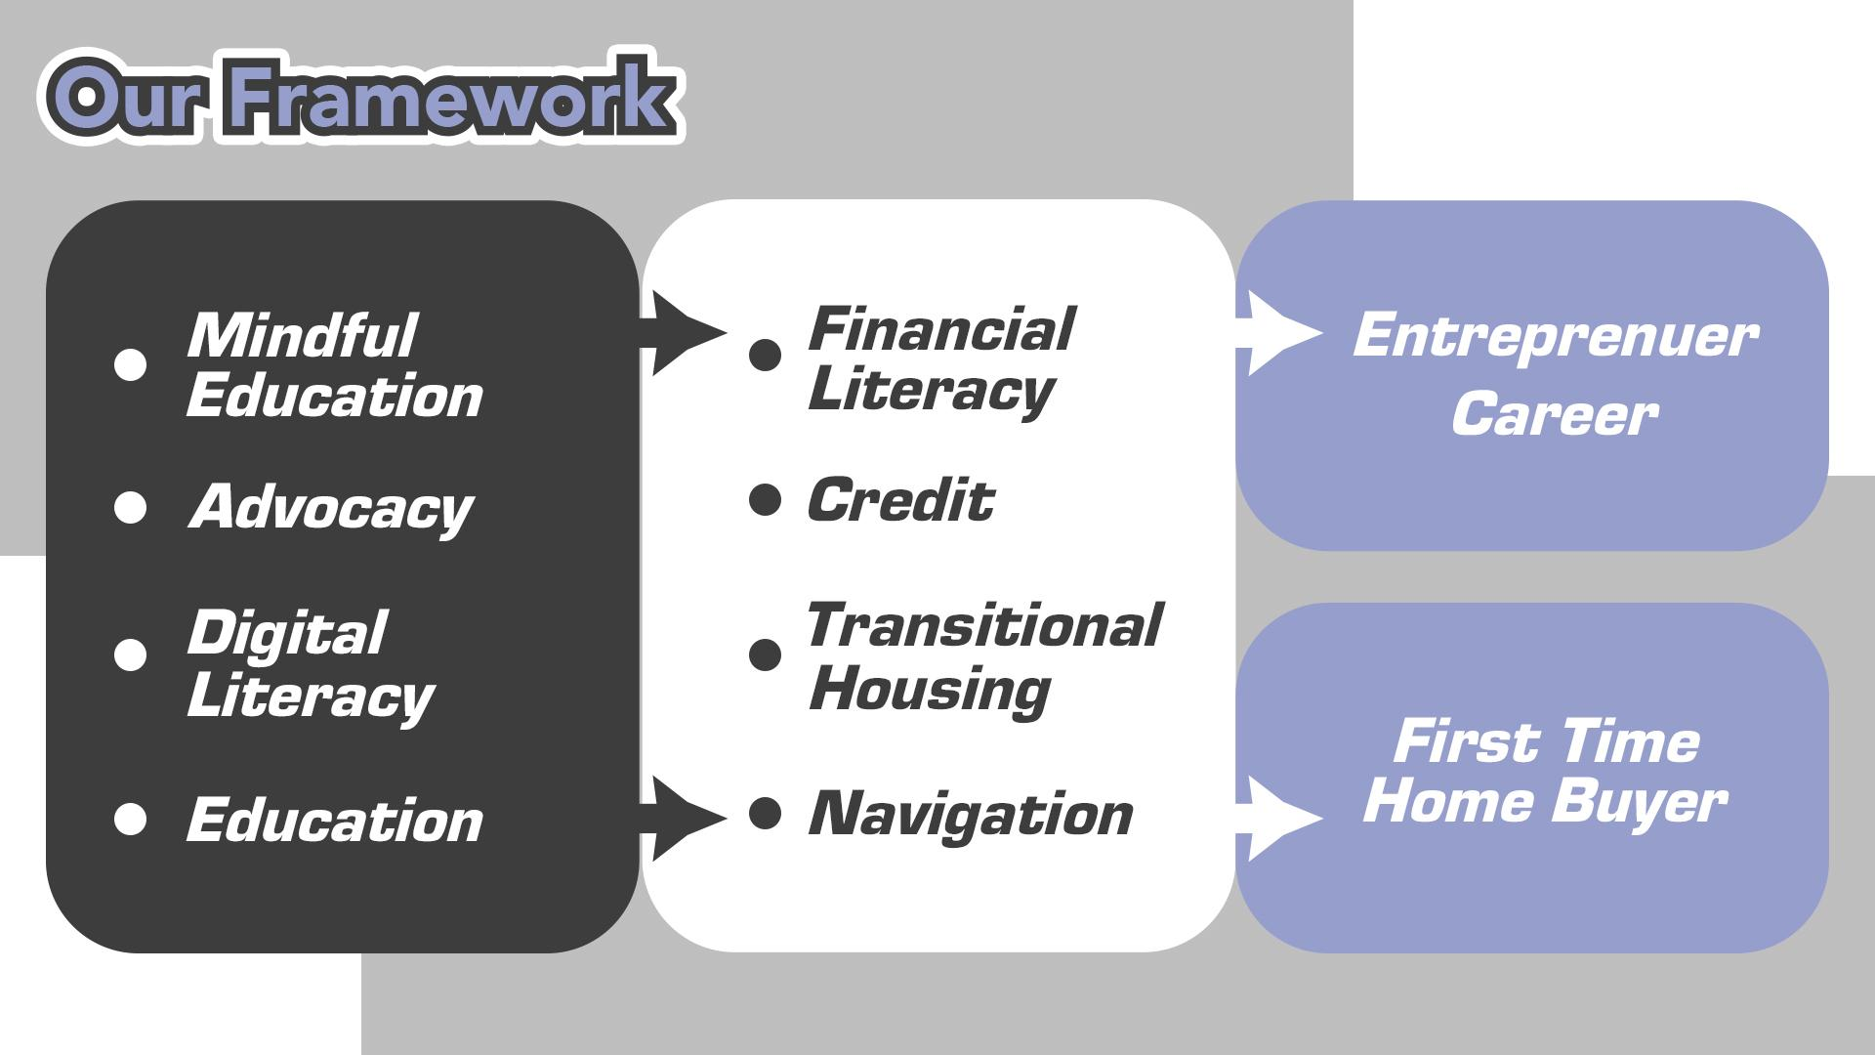

Slide 7
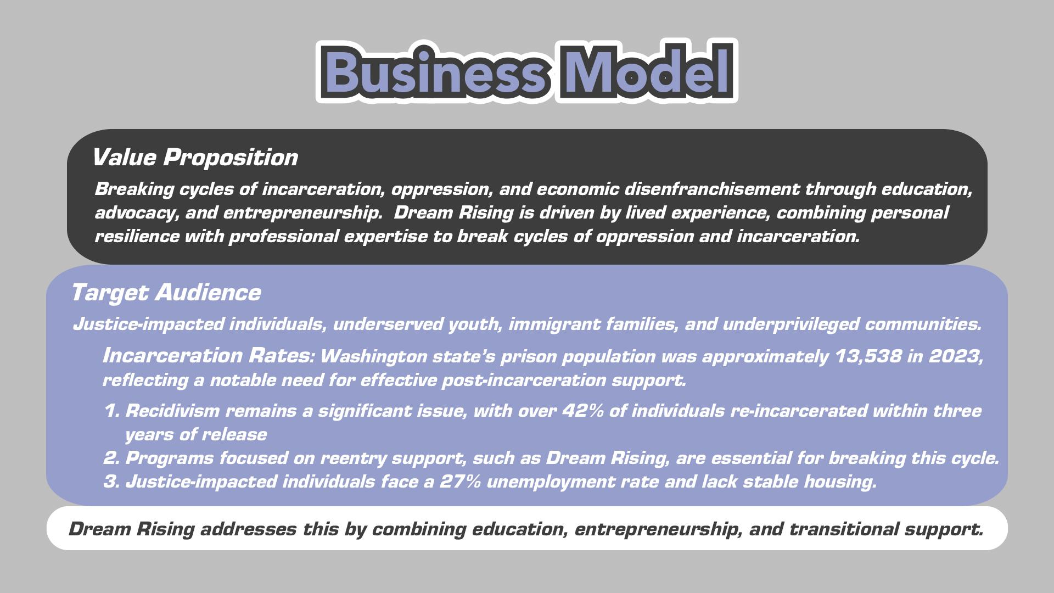

Slide 8

Dream Rising collaborates with nonprofits serving justice-impacted and underserved individuals but stands out by offering a unique blend of mindful education, digital/financial literacy, career/entrepreneur transitional housing to first-time home buyer. The target audience seeks accessible, empowering programs that address systemic barriers and provide long-term solutions. Dream Rising differentiates itself by focusing on holistic support, digital literacy, and financial empowerment to break cycles of poverty and incarceration.

Slide 9
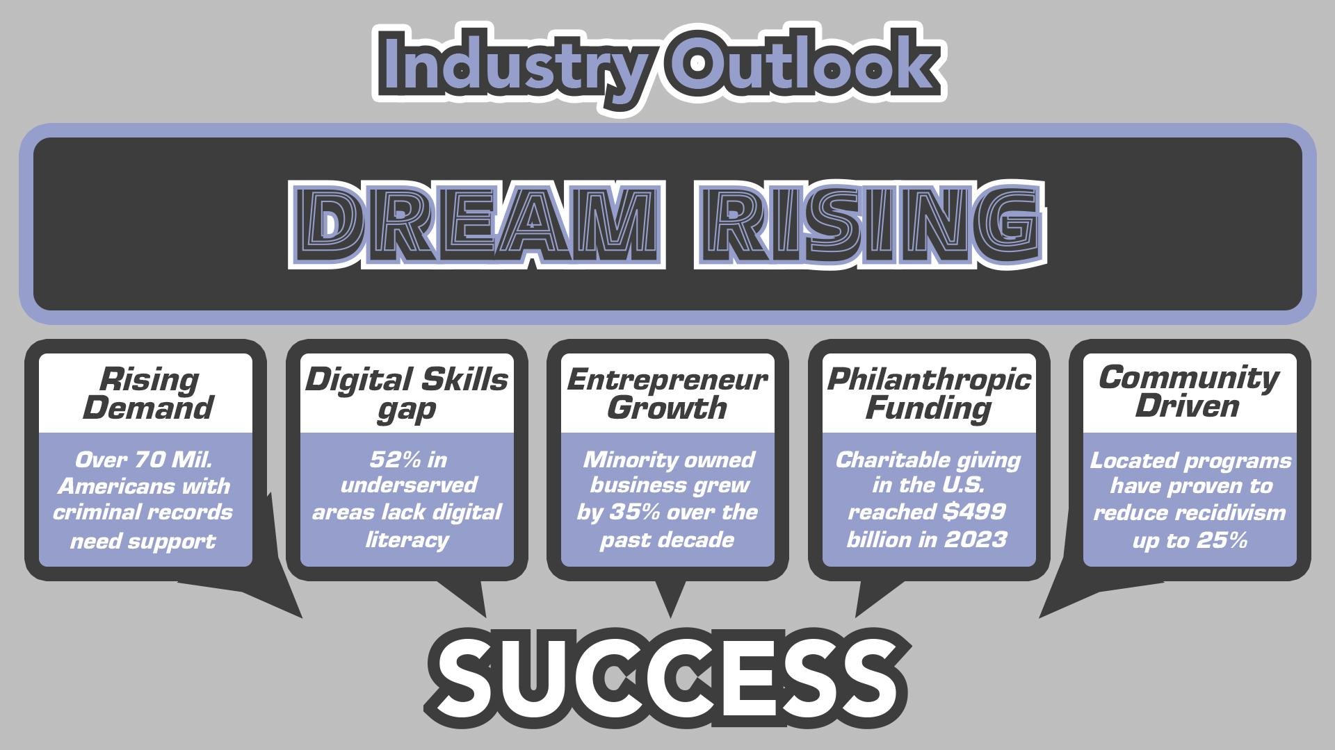

Slide 10
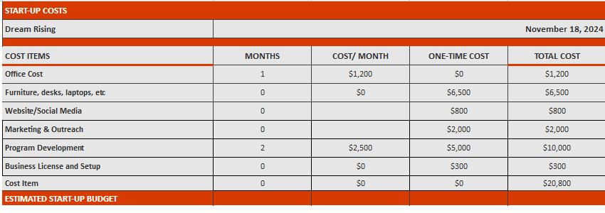
Start-Up Cost

Slide 11
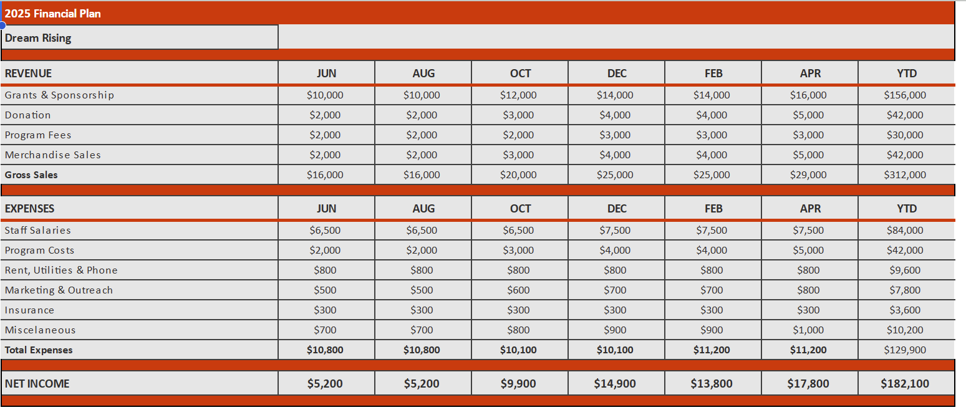
Finances 2025

Slide 12
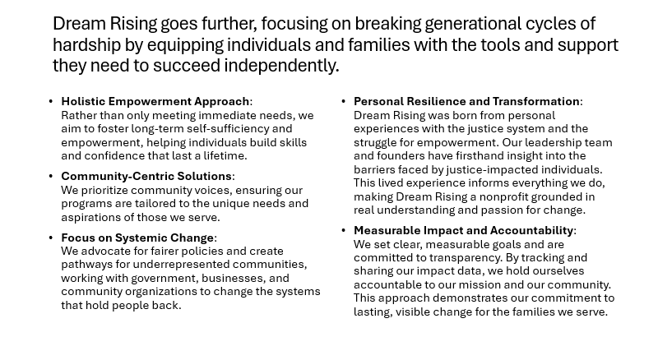

Slide 13
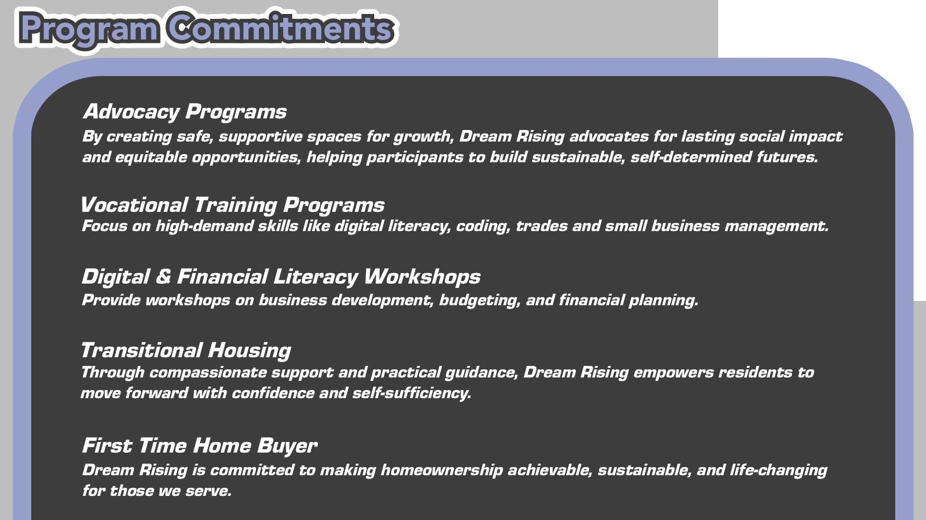

Slide 14
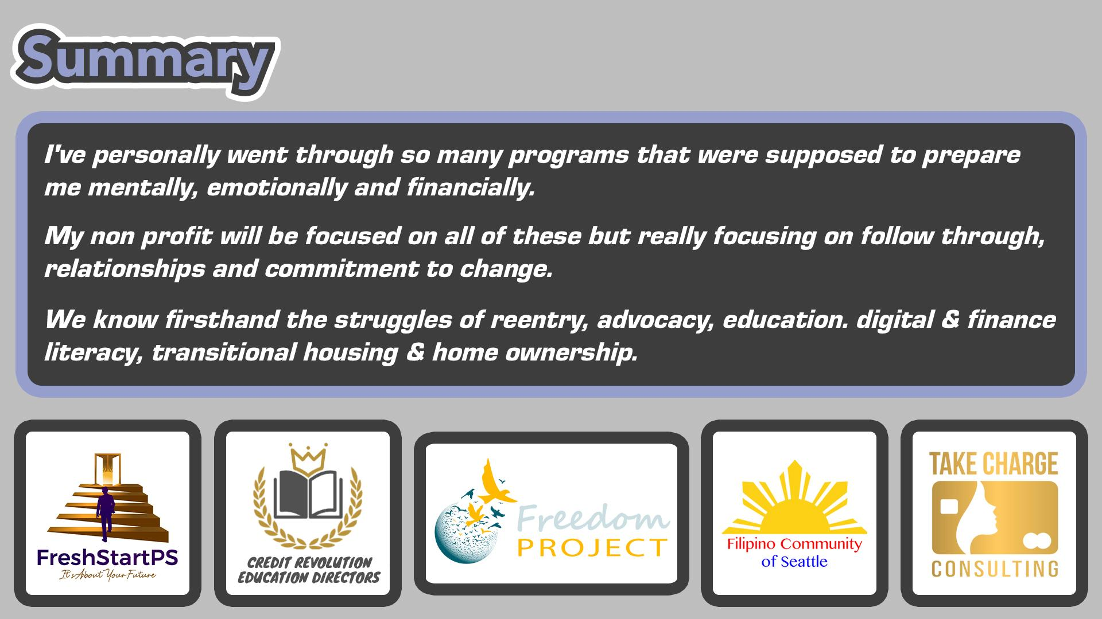

Slide 15


